Slide 1


22nd International Systems and
Software Product Line Conference
Sep. 10-14, 2018
Thorsten Berger
Associate Professor

Slide 2
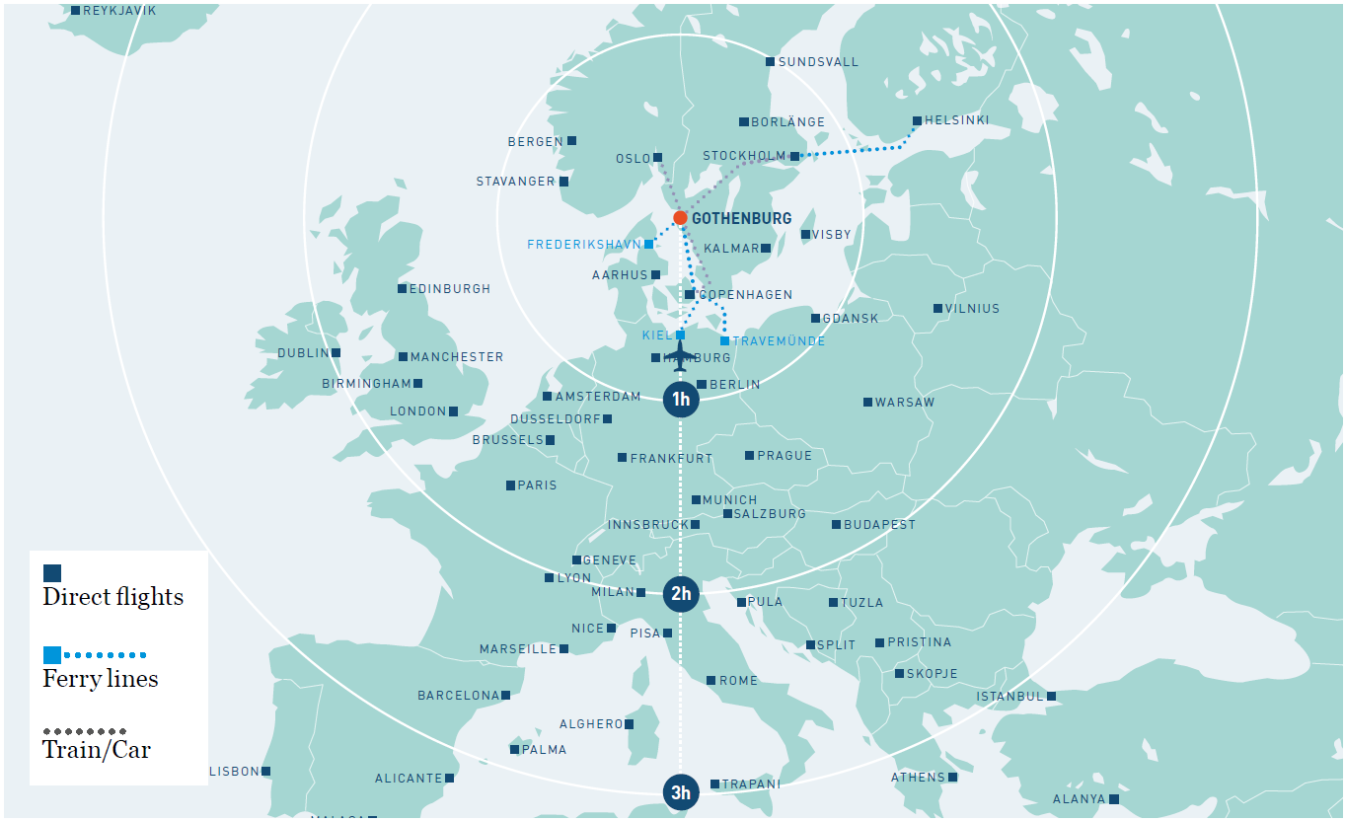
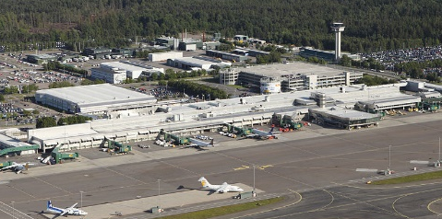
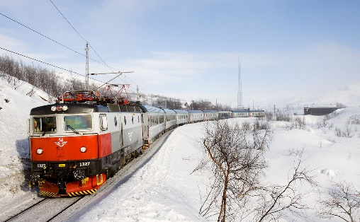
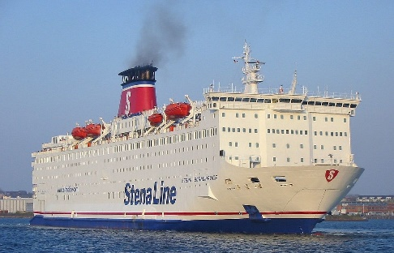
By plane
By train
By boat

Slide 3
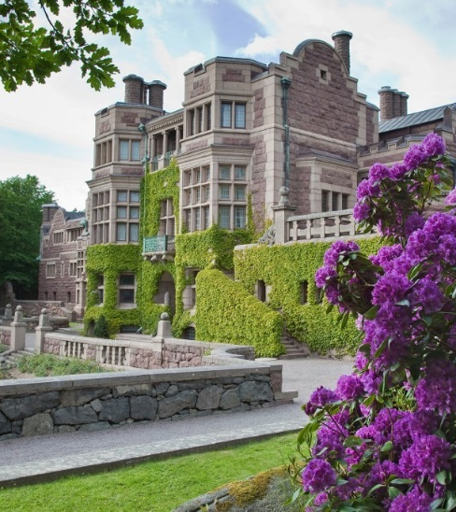
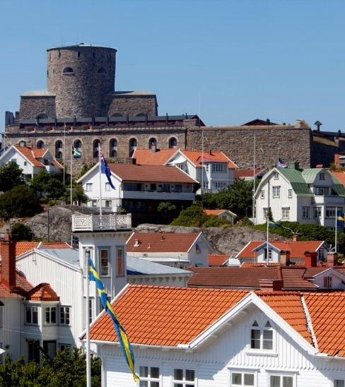
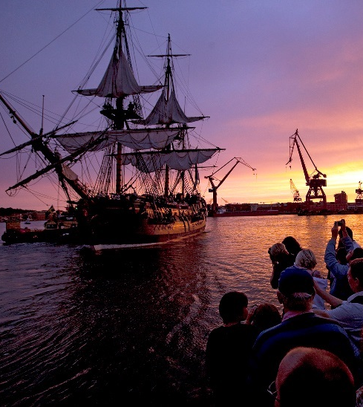
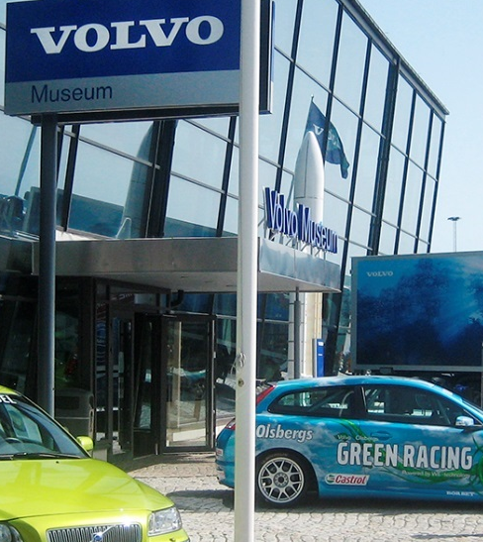
the city
Sweden’s 2nd largest city
founded: 1621
population: 980,000 (munic.)
large industries:
  Volvo, Ericsson, SAAB, ABB,
  Boeing, TetraPak, ALTRAN,
  Skype, Spotify, …
nature/culture
  islands and skerries: 50,000
  cafés: 500+
  Michelin restaurants: 7
music…

Slide 4
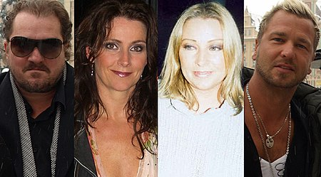
Gothenburg is the home of Ace of Base! ♪♫
https://en.wikipedia.org/wiki/Ace_of_Base

Slide 5
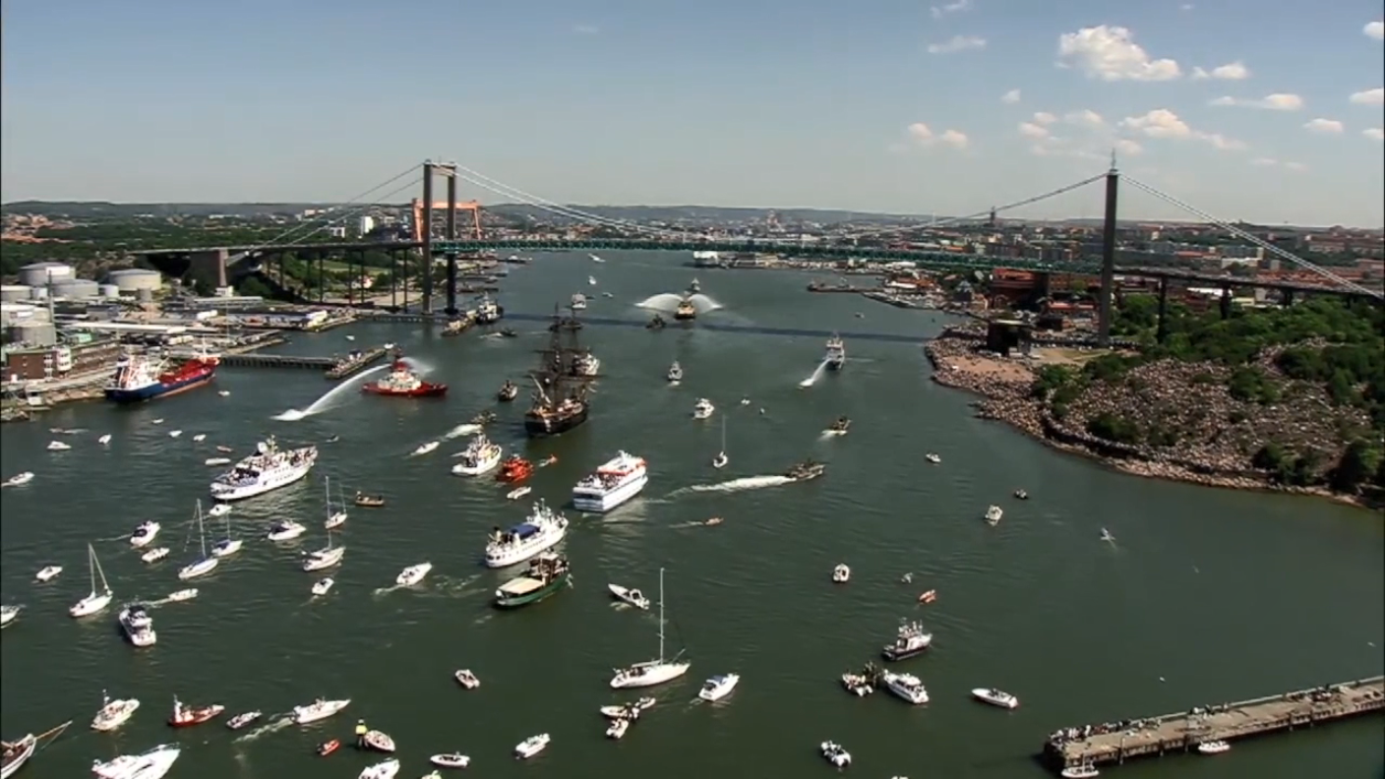
(video removed for size reasons; see website; best played with an Ace of Base soundtrack ♪♫)

Slide 6
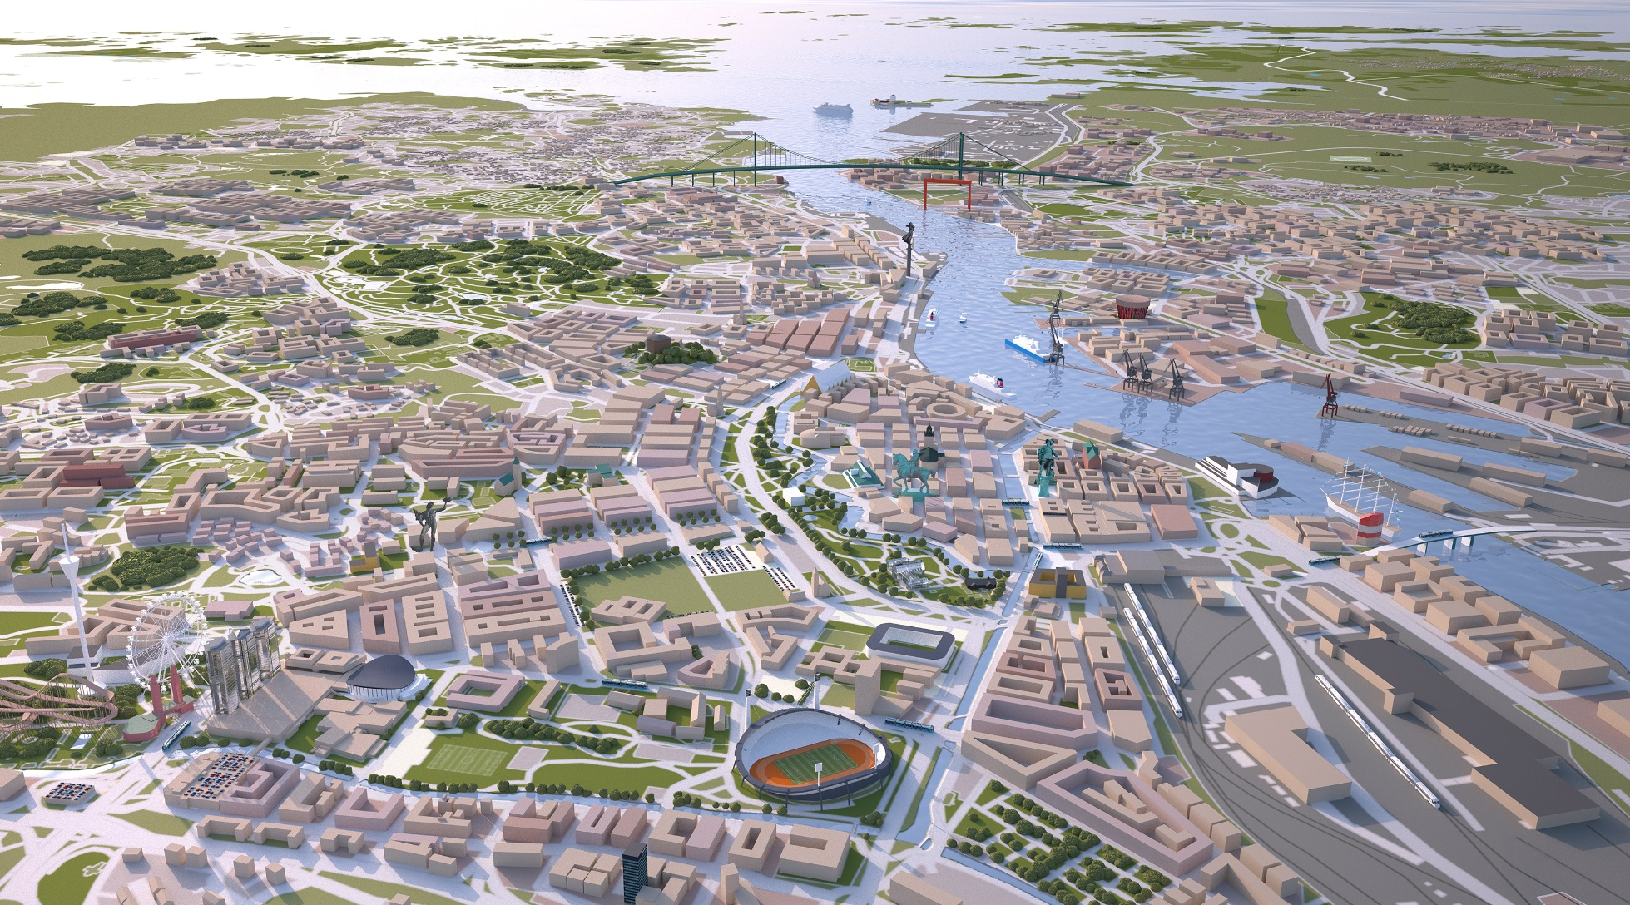
everything in walking distance
25 min. walking distance
or 10 min. transport
7,300 hotel rooms
> 450 restaurants/bars

Slide 7
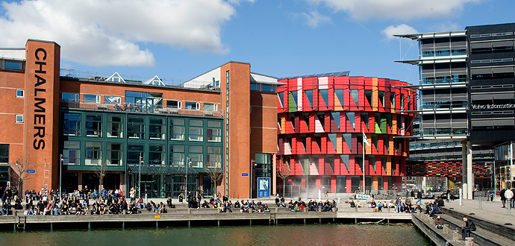
Chalmers | University of Gothenburg

Slide 8
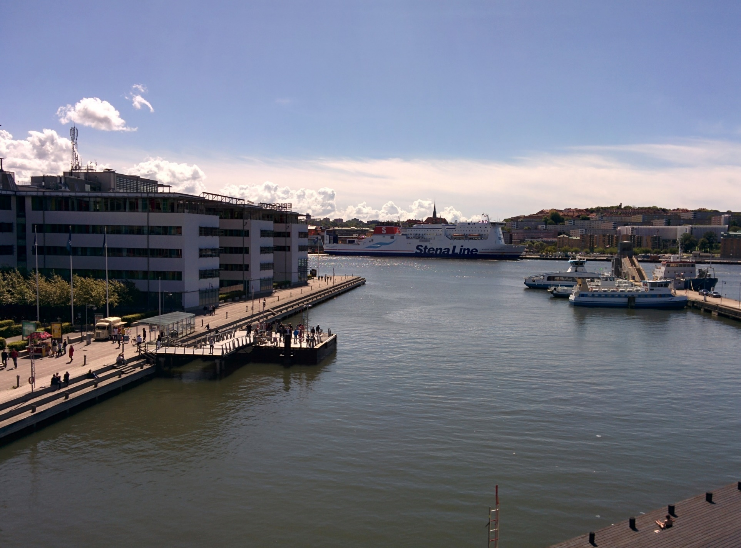

Slide 9
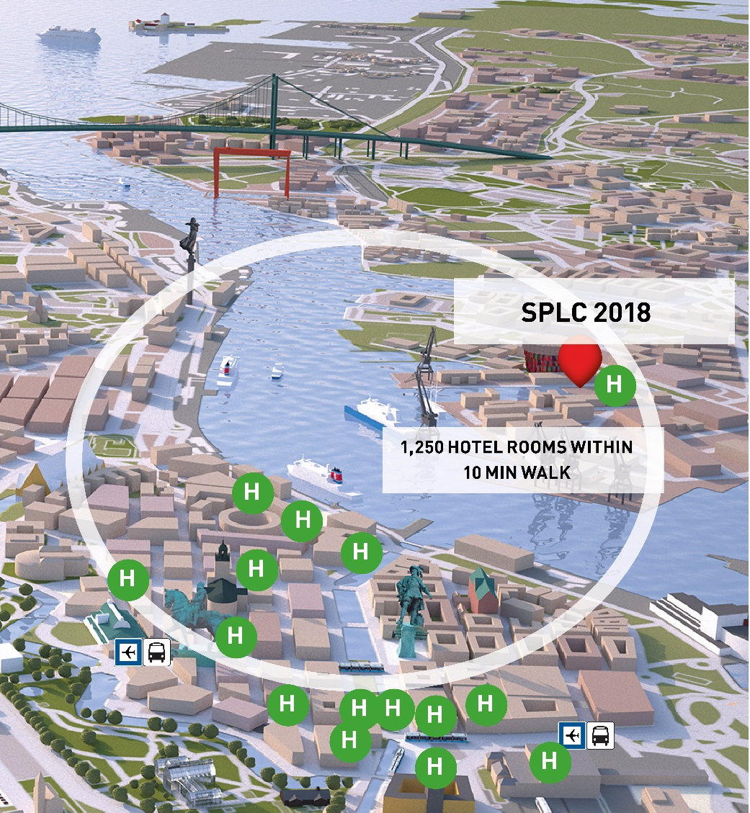
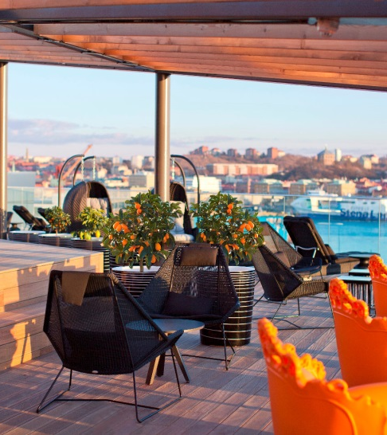
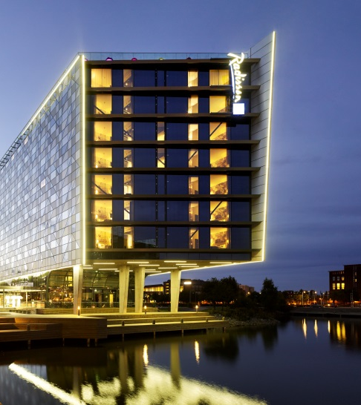
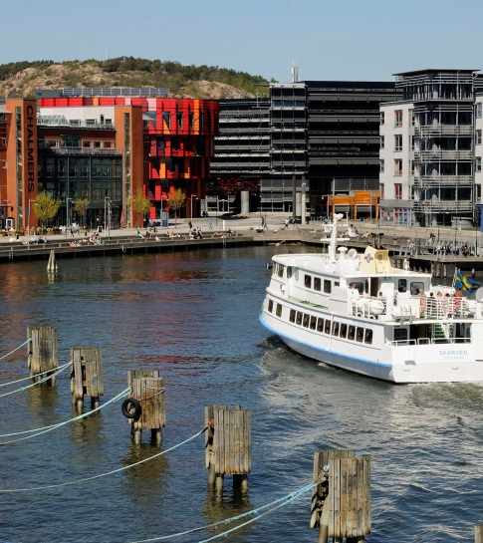
conference venue

Slide 10
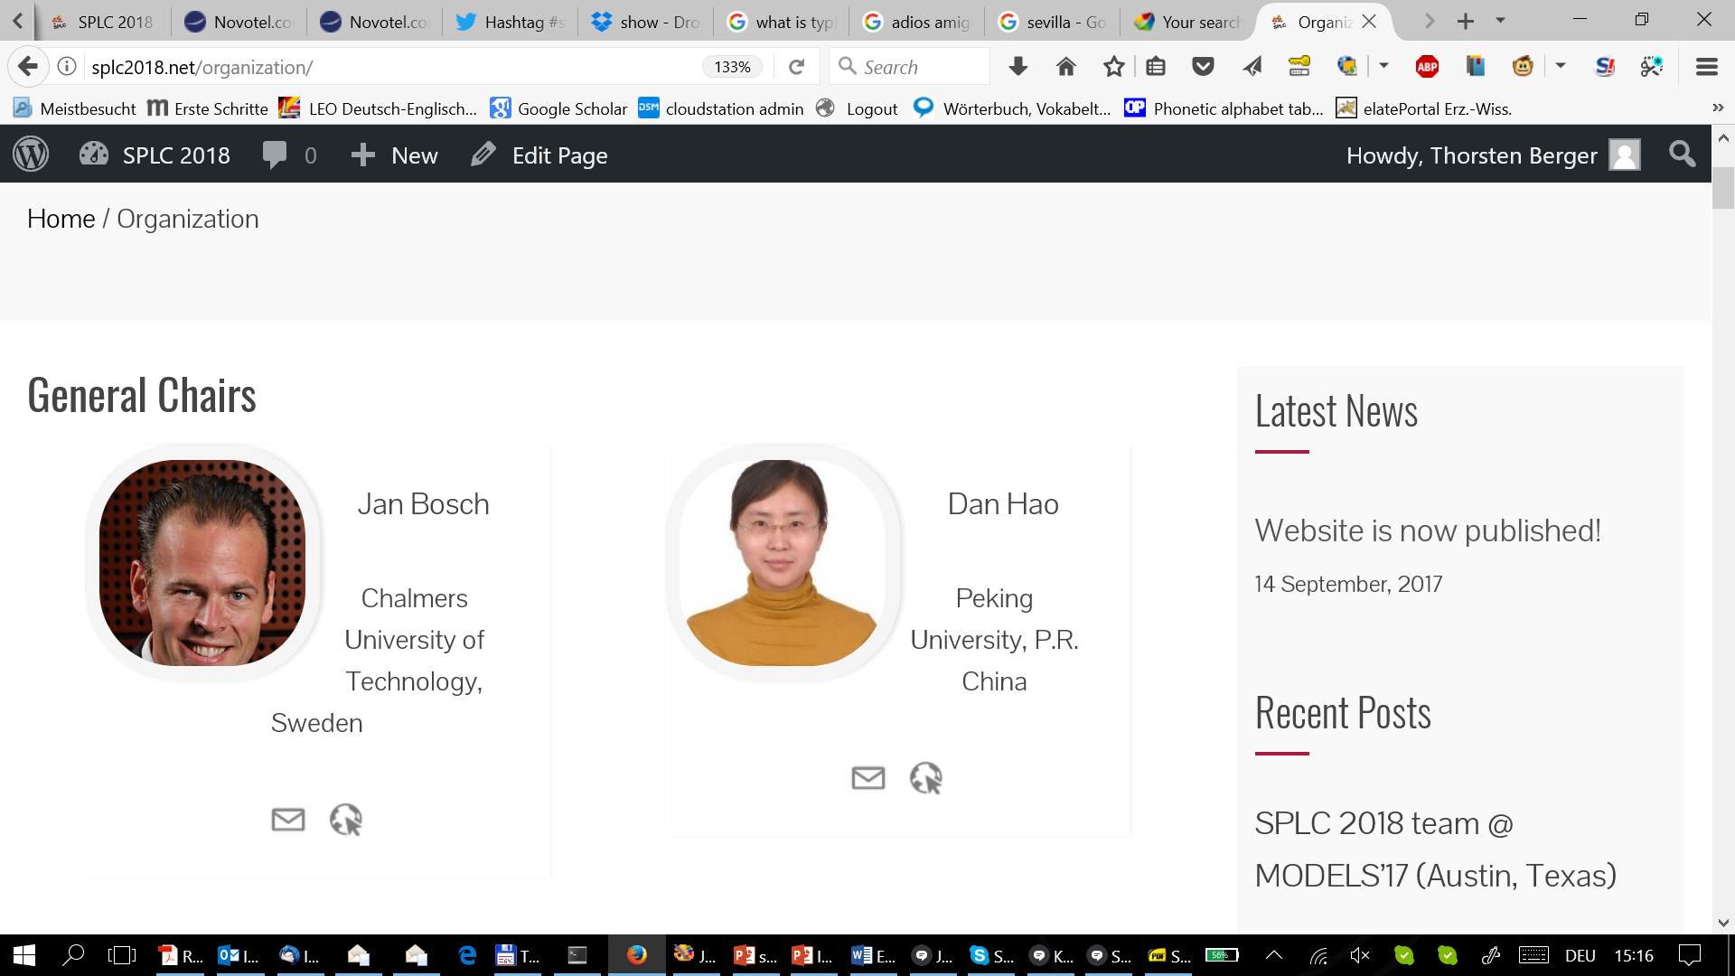
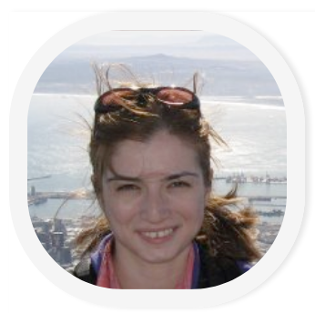
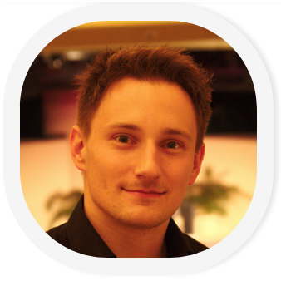

core team
general chairs
Jan Bosch
Dan Hao
conference chair
Gul Calikli
research track
chairs
Thorsten Berger
Paulo Borba

Slide 11
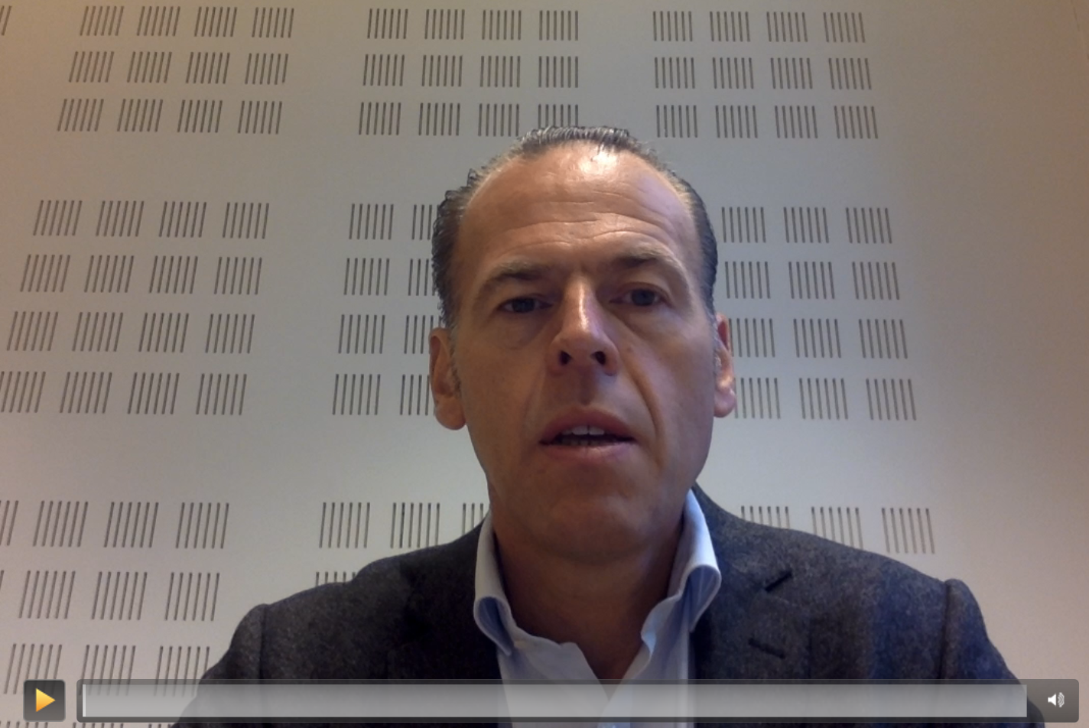
(video removed for size reasons; see website)

Slide 12
notable tracks

Slide 13
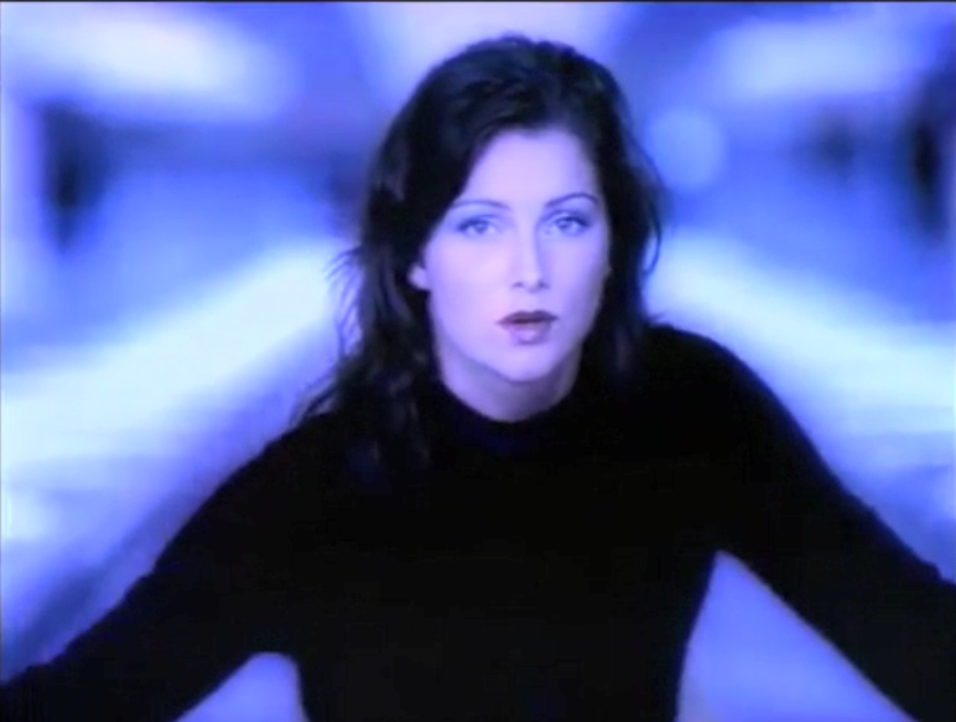
♪♫ Ace of Base – Living in Danger
(video snippet removed from this version)

Slide 14
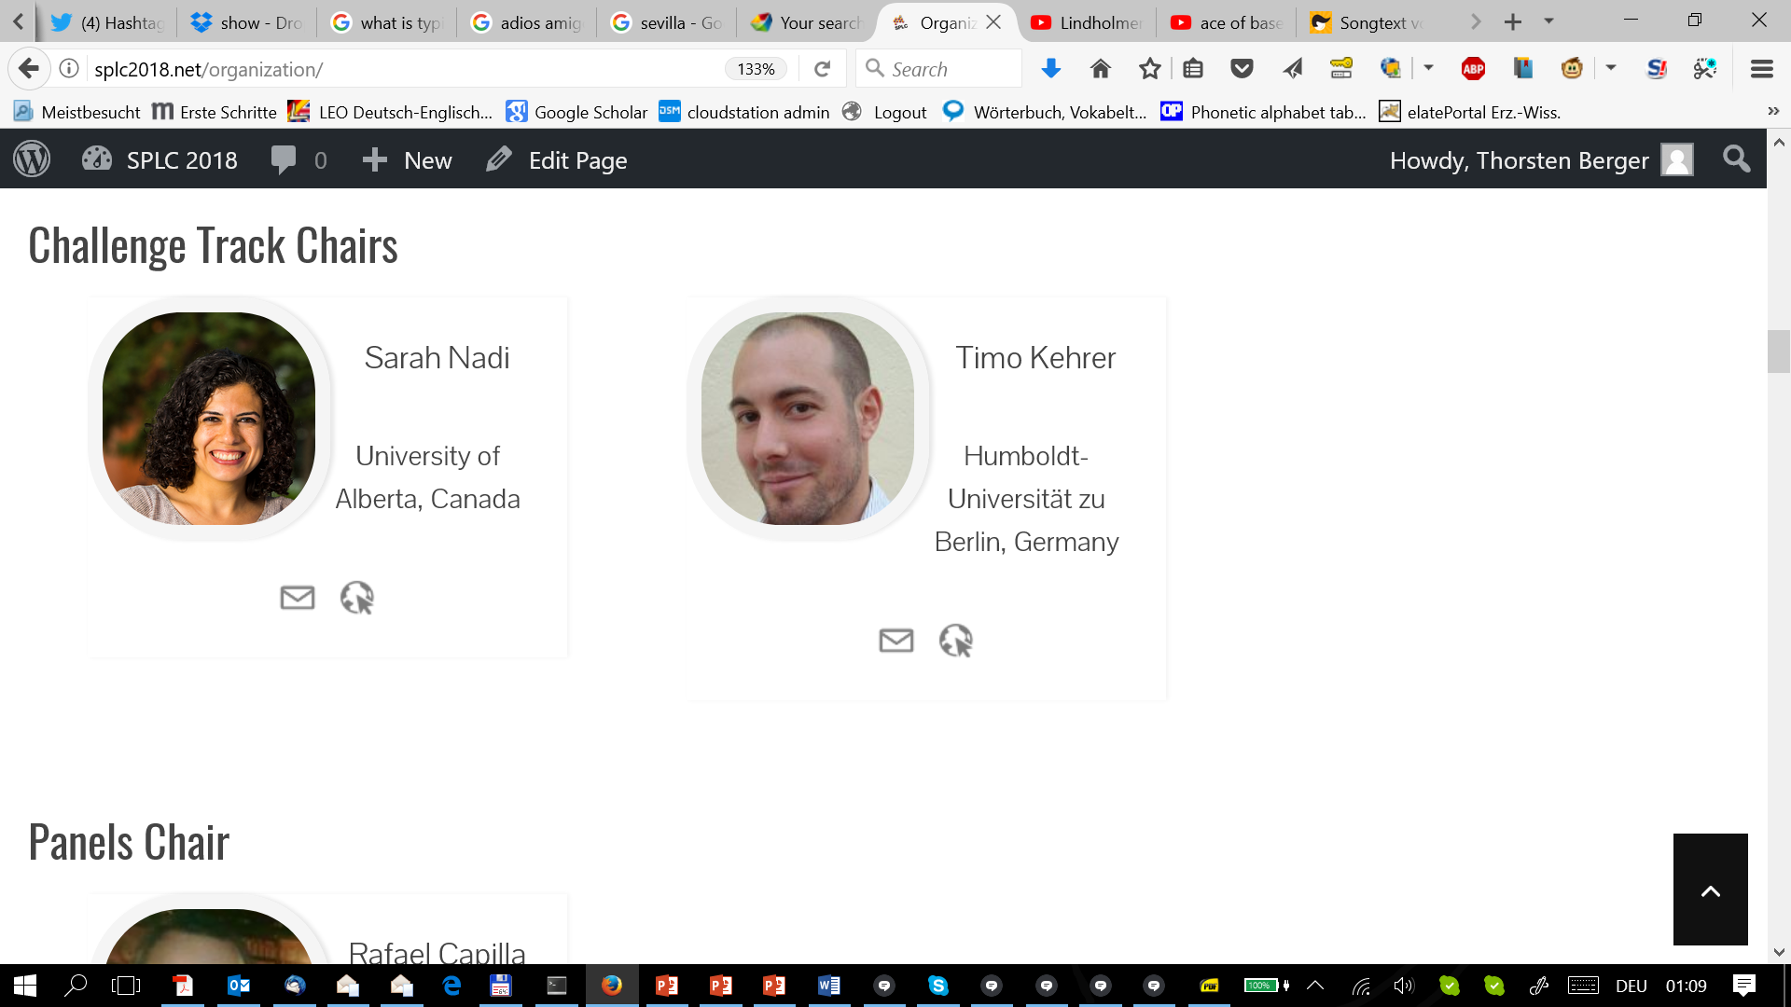
living in danger?
challenge track!
aims
  encourage junior newcomers to SPLC
  collect and consolidate experience with SPL technologies
  identify new technical challenges and research potential
format
  two-phase process: call for cases, then call for solutions
  multiple cases may be accepted
Sarah Nadi
Timo Kehrer
Notes:
encourage junior newcomers to SPLC by providing concrete problems

Slide 15
challenge track
submit a case
  share your particular challenge with the community
  call for cases will be an open call
a case is
  a dataset or system
  with specific questions to be answered or tasks to be performed
participate in the challenge
  4-page paper describing the solution
  published in the proceedings
  present at SPLC, compare with other solutions
Notes:
Why should you participate?
Both accepted case descriptions and solutions will be included in the conference proceedings
Cases may be the starting point for more general research benchmarks
Evaluate, compare and improve the maturity of your techniques and tools
Motivate students to work on a relevant problem of interest during their theses
Contribute to the SPLC community and help to push the community forward

Slide 16
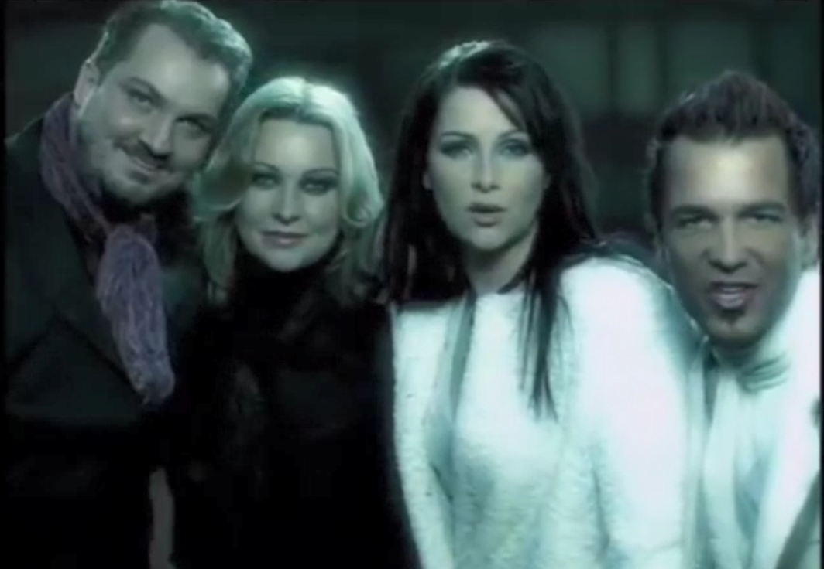
♪♫ Ace of Base – Unspeakable
(video snippet removed from this version)

Slide 17
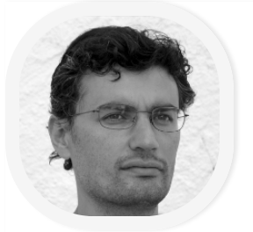
unspeakable?
journal first track!
aim
  increase visibility of journal papers
  no previous presentation at a conference
participation
  call for journal presentations
  invited presentations
David Benavides

Slide 18
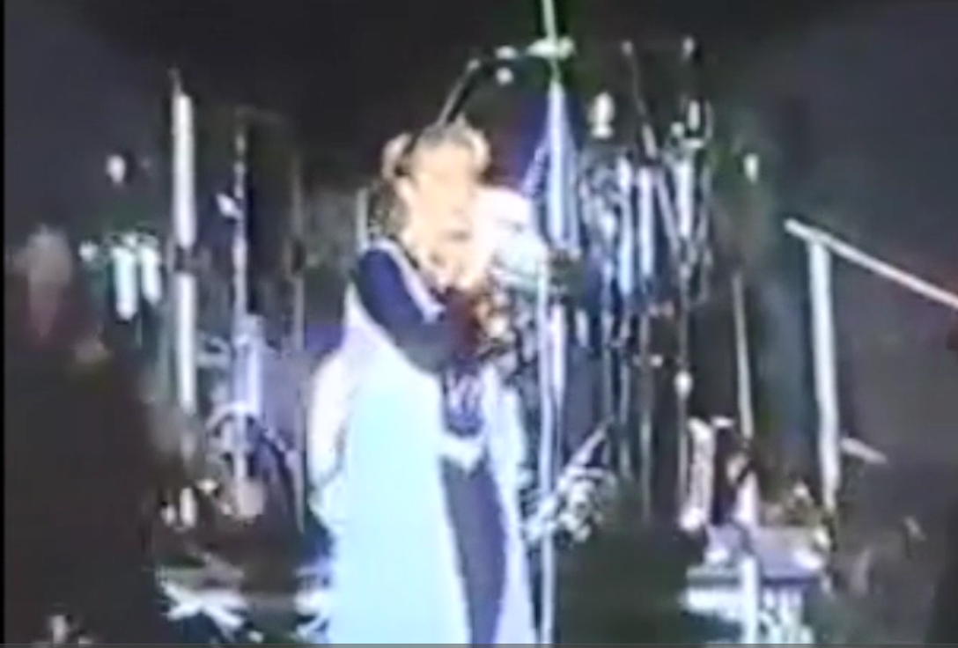
♪♫ Ace of Base – Young and Proud
(video snippet removed from this version)

Slide 19
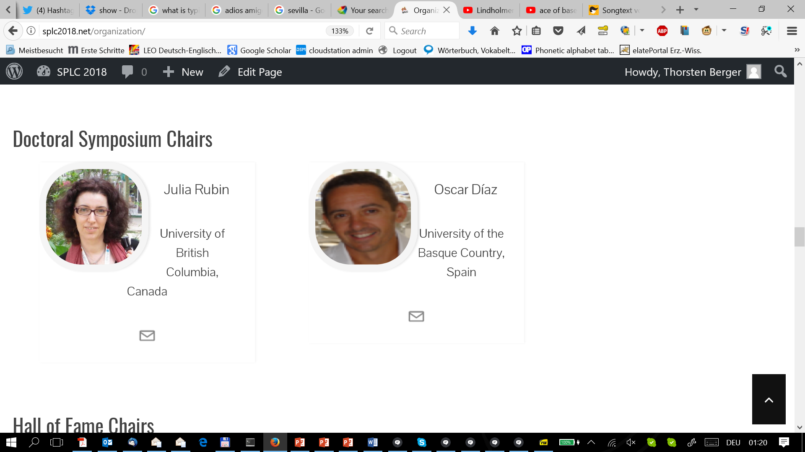
young and proud?
Julia Rubin
Oscar Diaz
doctoral symposium!
why to attend?
  technical feedback by the reviewing committee
  special emphasis on design-science training
  affordable conference fee
  free drinks!
Notes:
Devoted audience

Slide 20
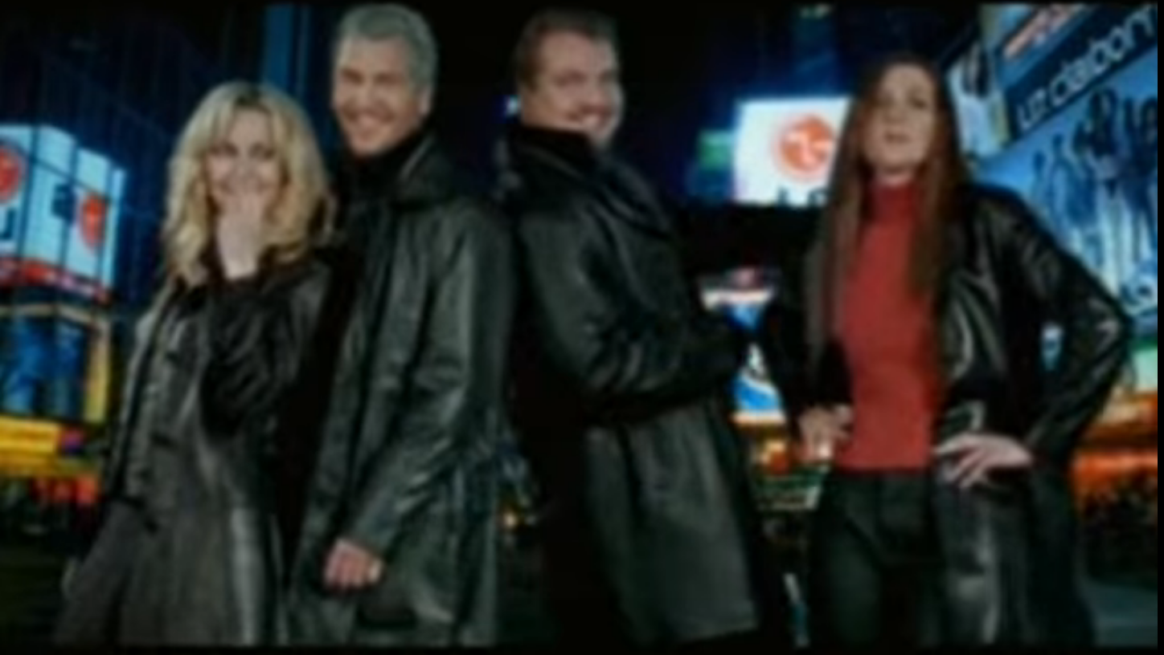
♪♫ Ace of Base – Change with the Light
(video snippet removed from this version)

Slide 21
change with the light?
new topics!
let us know about emerging topics
  mobile apps, AI, mining repositories, ...
incorporate via
  invited vision/perspective talks
  novel workshops
  industry participation
contact us!
@splcconf
www.splc2018.net

Slide 22
team

Slide 23
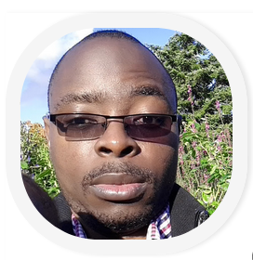
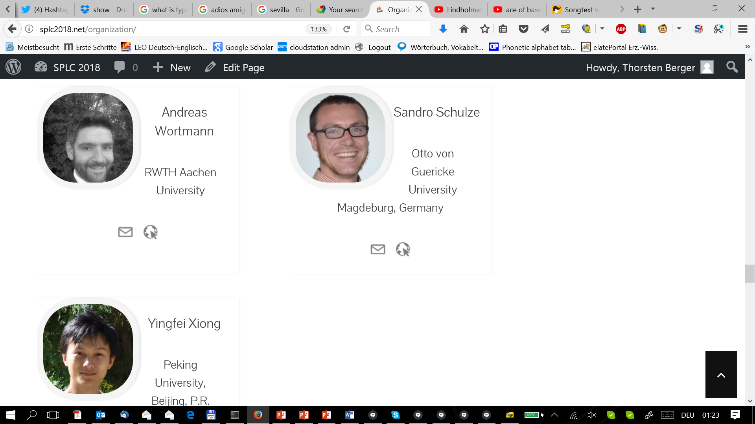
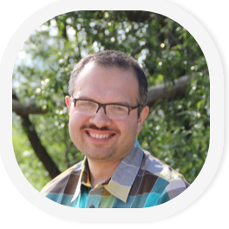
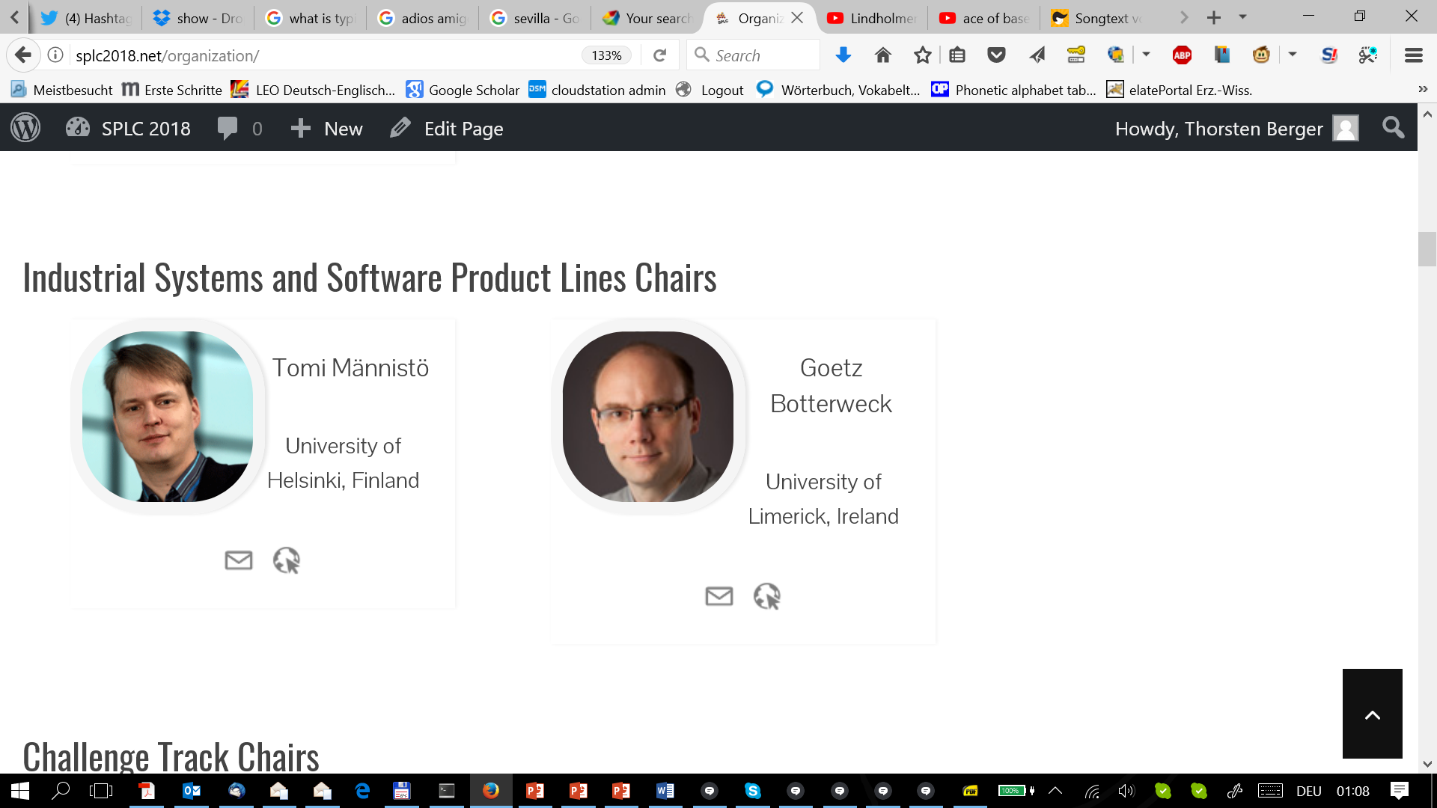
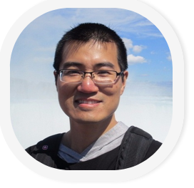
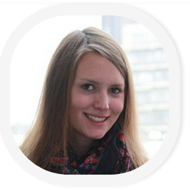
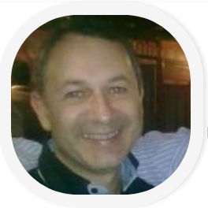
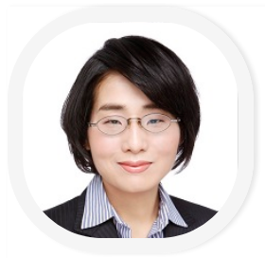
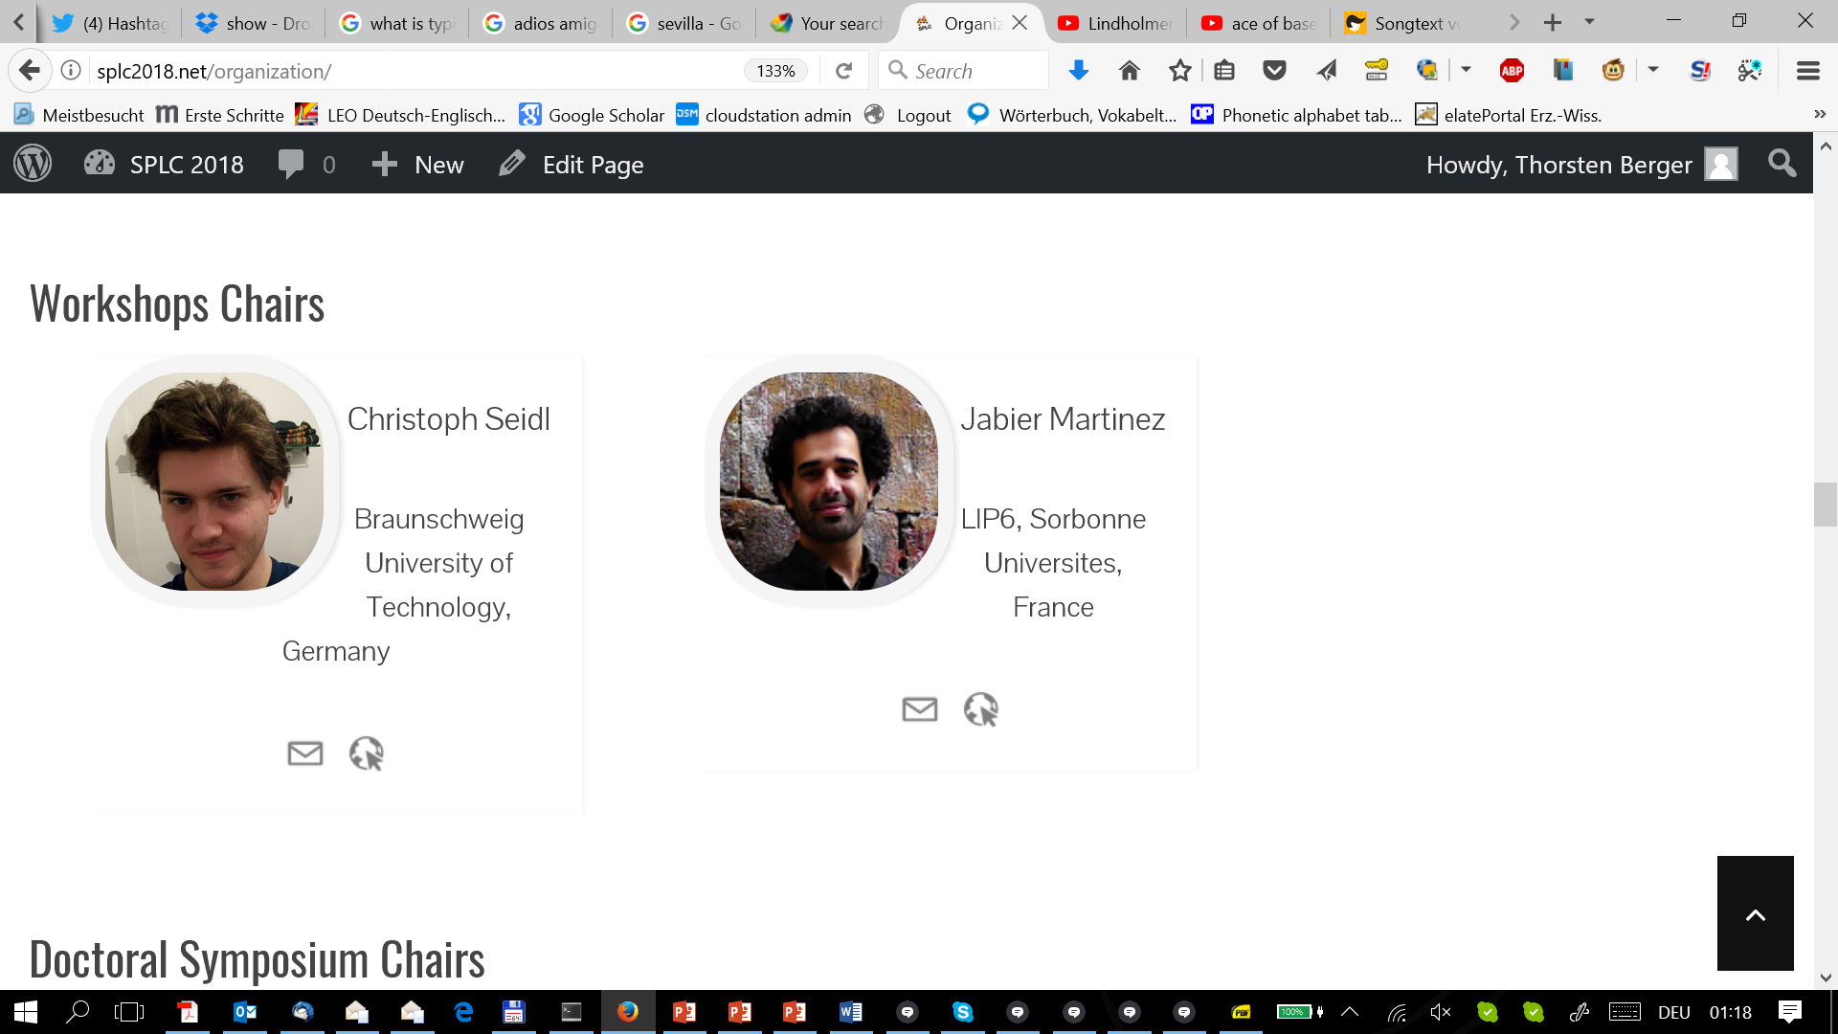
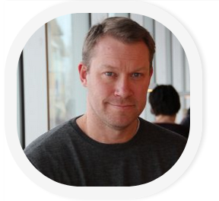
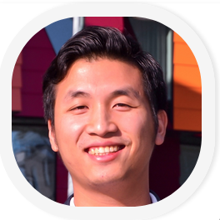
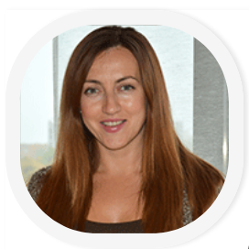
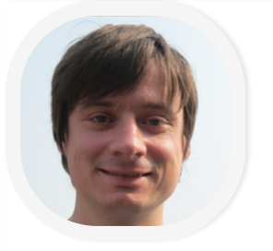
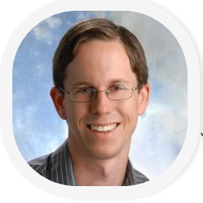
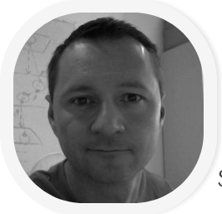
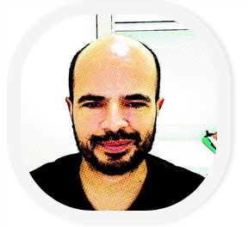
SPLC‘18 chairs
come to the stage!

Slide 24

“ This is as much Scandinavia
as you can get for your money.”
LONELY PLANET

Slide 25
22nd International Systems and
Software Product Line Conference
Sep. 10-14, 2018
Thorsten Berger
Associate Professor

